Slide 1
CASE STUDY WITH IEEE CODE OF ETHICS
Course: Engineering Ethics
Section: G
Course Faculty: DR. SHUVRA MONDAL

Slide 2
Group Members
SERIAL | NAME | ID
06 | BISHAL PAUL | 22-47036-1
07 | TAHSINUL ISLAM NISHAT | 22-47478-2
08 | AKID MAHMUD | 22-46211-1
09 | FARJANA YESMIN OPI | 22-47018-1
10 | MD. TANVIR ISLAM AKIB | 22-47816-2

Slide 3
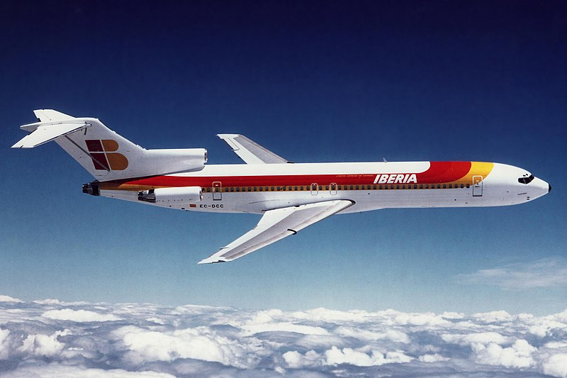
Table of contents
1
2
3
4
Brief Discussion about IEEE
IEEE Code of Ethics No 1
Case Study
Conclussion

Slide 4
What is IEEE CODE OF ETHICS
The IEEE Code of Ethics outlines a set of principles intended to guide members in making ethical decisions and conducting themselves professionally.

Slide 5
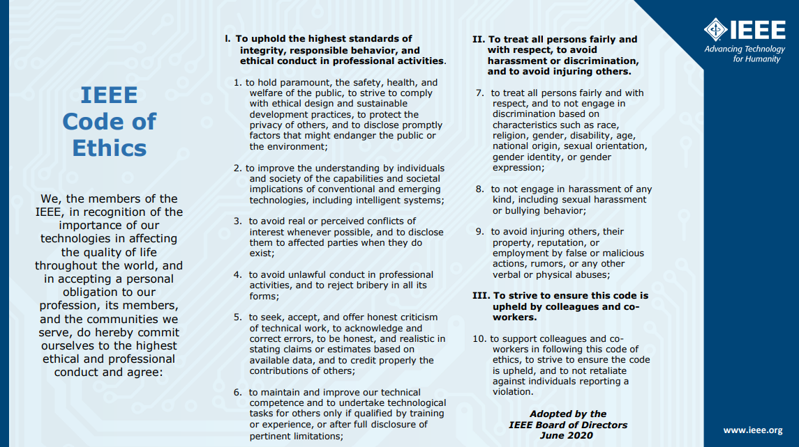
IEEE Code of Ethics

Slide 6

Purpose
Public Safety.
Better Understanding of Duties.
Prevent conflicts of Interest.
Recognize Moral Awareness.
To be Able to Maintain Confidentiality.
Encourage Fairness and Respect.

Slide 7
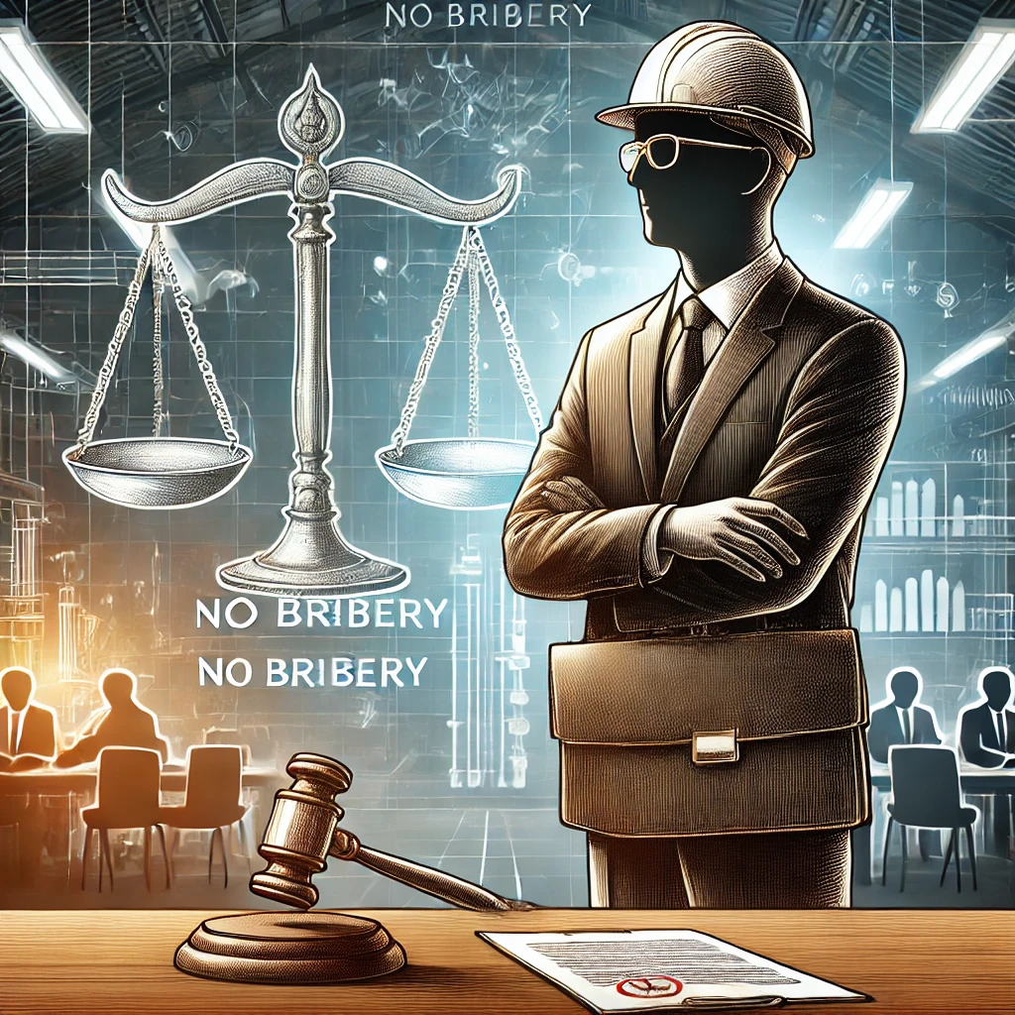
IEEE Code of Ethics Number 01:
to hold paramount, the safety, health, and welfare of the public, to strive to comply with ethical design and sustainable development practices, to protect the privacy of others, and to disclose promptly factors that might endanger the public or the environment;

Slide 8

Significance
Public Safety, Health and Welfare.
Ethical Design.
Sustainable Development.
Privacy Protection.
Prompt Disclosure of Risks.

Slide 9
Implications and Application Area
Must Prioritize safety in product development.
Design Products to minimize environment impact.
Handle personal data ethically.
Disclose factors that endanger public safety.
Applications in Healthcare, transportation, finance, biotechnology And others

Slide 10

Consequences
Legal and Regulatory Repercussions.
Reputation Damage.
Financial and Operational Risks.
Loss of Professional Standing

Slide 11
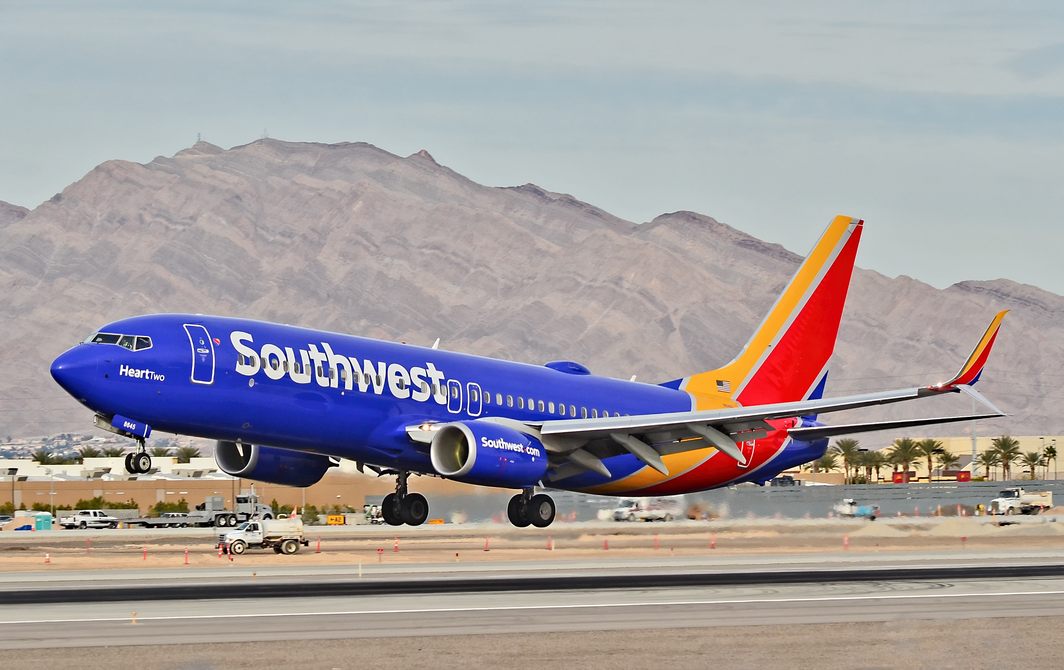
Case Study
Boeing Engineers and the 737 Max Scandal

Slide 12

CASE STUDY
Boeing, a leading aerospace company, faced pressure to compete with Airbus’s A320neo, leading to the development of the 737 Max with the MCAS software. Despite engineers raising concerns about the software’s safety risks, management prioritized deadlines and cost savings, failing to address these warnings adequately.
Tragically, two crashes involving the 737 Max in 2018 and 2019 killed 346 people, with investigations revealing that the MCAS was a key factor. The decision to prioritize speed over safety resulted in a global grounding of the fleet, a $2.5 billion settlement, and reputational damage to Boeing.
The dilemma highlighted a conflict between safety and business priorities. Engineers and leadership had to choose between delaying the release to address safety concerns or meeting deadlines to maintain market competitiveness.

Slide 13
QUESTION
Should Boeing’s engineers have delayed the 737 Max release to ensure safety or complied with management’s directives to meet business goals?

Slide 14
Key Information of the Case
Boeing developed the 737 Max to compete with Airbus’s A320neo.
Racing to maintain its competitive edge in the aerospace market.
The aircraft included the MCAS software to enhance performance.
Safety concerns were raised by engineers during development.
Management prioritized deadlines and cost savings over addressing these concerns
Potential risks included software malfunction leading to loss of flight control.
Past incidents resulted in two crashes, killing 346 people.
Risk of significant financial losses and market share if delayed.
Ignoring safety concerns led to global grounding and reputational damage.

Slide 15
Violation of IEEE Code of Ethics 1:
Failure to Prioritize Public
Safety concerns ignored to meet deadlines.
Resulted in two fatal crashes.
Neglect of Ethical Design Practices
Inadequate testing and redundancy in MCAS.
Insufficient pilot training.
Delayed Disclosure of Risks
Safety risks were not disclosed after the first crash.
Business Goals Over Public Welfare
Prioritized market competition over safety.

Slide 16

Ethical Dilemma
Boeing engineers, responsible for the development of the 737 Max, faced intense pressure from management to meet production deadlines and control costs to compete with Airbus’s A320neo. While concerns were raised about the safety of the MCAS software during development, these were not fully addressed to keep the project on schedule. The engineers had to decide whether to insist on delaying the aircraft’s release to resolve safety issues or comply with management’s directives, risking potential safety failures that could endanger lives and damage Boeing’s reputation.

Slide 17

Four Steps For Resolving Ethical Dilemma
1
2
3
4
Moral Clarity
Knowing facts
Consider the Options
Make a reasonable decision

Slide 18
Step 1: Moral Clarity:
Prioritizing public safety: The engineers had a moral obligation to prioritize lives over business goals.Changes in Government Regulations
Responsibility as engineers: They were duty-bound to uphold ethical standards and ensure safety.Financial Market Volatility Risk
Short-term sustainability: Delaying the launch would hurt competitiveness but prevent greater long-term harm
The Boeing engineers, responsible for the development of the 737 Max, faced a conflict between the urgency to meet tight production deadlines and the necessity to address safety concerns related to the MCAS software, ensuring the aircraft’s safety for passengers and crew.

Slide 19
Step 2: Knowing facts:
Boeing engineers raised safety concerns about the MCAS software, which were not fully addressed.
Financial pressures were high, with Boeing racing against Airbus to retain market leadership.
Potential risks included system malfunctions causing loss of flight control and fatal crashes.
Long-term consequences involved reputational damage, legal liabilities, and loss of customer trust.

Slide 20
Step 3: Consider the Options
Option 1: Proceed with the Release of the 737 Max on Schedule
Pros: Maintains market competitiveness, avoids immediate financial losses, and meets production deadlines.
Cons: Risks passenger and crew safety, potential for catastrophic accidents, long-term reputational damage, and costly legal consequences.
Option 2: Delay the Release to Address Safety Concerns
Pros: Ensures thorough testing and safety, protects lives, upholds ethical standards, and safeguards Boeing’s reputation in the long run.
Cons: Leads to short-term financial losses, potential loss of market share to Airbus, and strained stakeholder relationships.

Slide 21
Step 4: Make a reasonable decision:
Delay the release to address safety concerns, which aligns with Option 2.
Reason for taking this decision: IEEE code of ethics number one:
“to hold paramount, the safety, health, and welfare of the public, to strive to comply with ethical design and sustainable development practices, to protect the privacy of others, and to disclose promptly factors that might endanger the public or the environment”

Slide 22
According to IEEE Code of Ethics No 01
Prioritize public safety, health, and welfare over competitive deadlines.
Adhere to ethical design and sustainable development practices.
Disclose promptly any factors that could endanger public health or the environment.
Communicate openly about risks associated with releasing GM seeds without completing essential safety tests.
Delay release to ensure thorough testing and mitigate potential risks.

Slide 23

Conclusion
Delaying the release of the 737 Max to address safety concerns aligns with ethical responsibilities and long-term sustainability. Prioritizing public safety over deadlines safeguards lives, upholds professional integrity, and prevents reputational and financial damages, demonstrating adherence to the IEEE Code of Ethics.

Slide 24
Thank You

